Slide 2
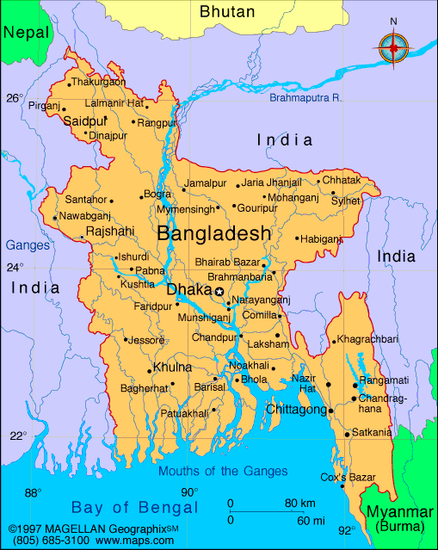
Bangladesh

Slide 3
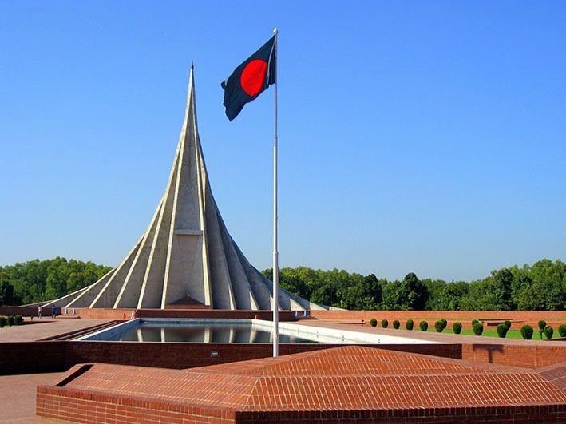
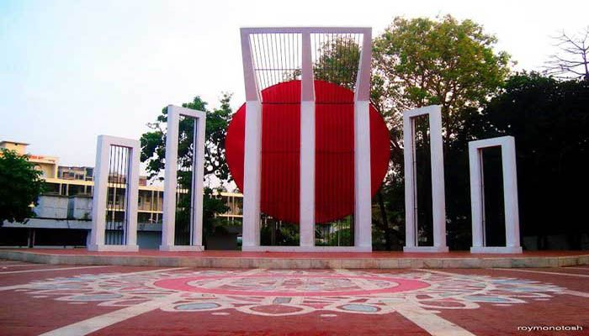
Historical Place of Bangladesh
1. National Memorial, 2.Shahid Minar

Slide 4
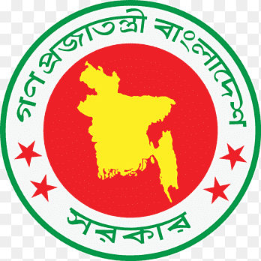
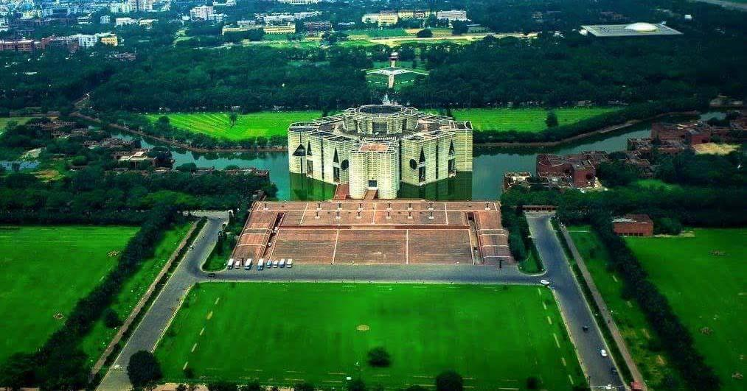
Government system of Bangladesh
The Government of the People's Republic of Bangladesh (Bengali: গণপ্রজাতন্ত্রী বাংলাদেশ সরকার — Gôṇôprôjātôntrī bānglādēsh shôrkār) is the central executive government of Bangladesh. The government was constituted by the Constitution of Bangladesh comprising the executive (the president, prime minister and cabinet), the legislature (the Jatiya Sangsad), and the judiciary (the Supreme Court). Bangladesh is a unitary state[1] and the central government has the authority to govern over the entirety of the nation. The seat of the government is located in Dhaka, the capital of Bangladesh

Slide 5
Population of Bangladesh
Year Population Migrants (net)
2024 173,562,364 -473,362
2023 171,466,990 -549,918
2022 169,384,897 -549,990
2020 166,298,024 -1,002,522

Slide 6


Banking system of Bangladesh
Banks After the independence, banking industry in Bangladesh started its journey with 6 Nationalized commercialized banks, 3 State owned Specialized banks and 9 Foreign Banks. In the 1980's banking industry achieved significant expansion with the entrance of private banks. There are 62 scheduled banks in Bangladesh who operate under full control and supervision of Bangladesh Bank which is empowered to do so through Bangladesh Bank Order, 1972 and Bank Company Act, 1991.

Slide 7
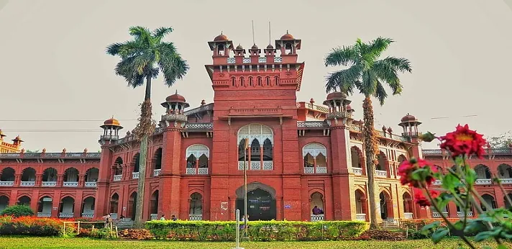

Education System of Bangladesh
Education in Bangladesh is administered by the country's Ministry of Education. The Ministry of Primary and Mass Education implements policies for primary education and state-funded schools at a local level. Education in Bangladesh is compulsory for all citizens until the end of grade eight. Primary and secondary education is funded by the state and free of charge in public schools

Slide 8
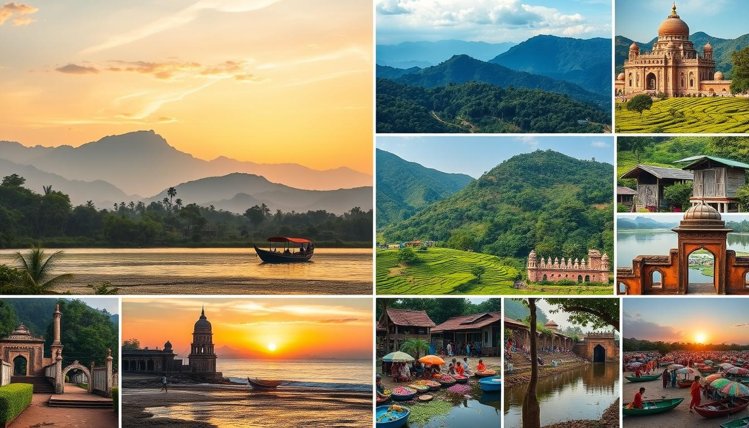
Tourist places in Bangladesh
Some of the top tourist places in Bangladesh include:
Cox's Bazar: A popular destination with beaches, cliffs, surfing, pagodas, temples, and seafood
Shahid Minar: A symbol of Bangladesh's history and fight for independence
Lalbagh Fort: A heritage site in Dhaka
Ruins of the Buddhist Vihara at Paharpur: A World Heritage Site in Rajshahi
The Sundarbans: A World Heritage Site in Khulna
Historic Mosque City of Bagerhat: A World Heritage Site in Khulna
Sajek Valley: A scenic valley
St. Martin's Island: A tourist attraction
Royal Bengal Tigers: A tourist attraction
Freshwater pink dolphins: A tourist attraction

Slide 9

Lets Enjoy the Beautiful Bangladesh

Slide 10


